Slide 1
Lecture 11alt
Advances in Combinational ATPG Algorithms
Branch and Bound Search
FAN – Multiple Backtrace, head lines (1983)
TOPS – Dominators (1987)
SOCRATES – Learning (1988)
EST – Search space learning (1991)
ATPG Performance improvements
Summary

Slide 2
ATPG: A Boolean Satisfiability Problem
CUT
Test
Vector
(a,b,c)
f(a,b,c) = 1
CUT
with fault

Slide 3
SAT is NP-Complete
f
a
b
c
f
Binary Decision
Diagram (BDD)
a
0
1
b
b
c
c
c
c
0
0
0
0
0
1
1
1

Slide 4
Search for a Solution
Problem: Given a value of a Boolean function of binary variables, find values of the variables.
Solution: Starting at the root, enumerative traversal of the binary decision diagram (BDD) until a solution is found.
BDD is a search tree – search consists of
  Branch: Set an untried value for a variable
      Backtrack to previous branching point if there is no untried value
    Stop if solution found, or backtracked to root without untried values
    Or, bound search tree for future traversals if solution is impossible and backtrack to previous branching point (some variable orderings may lead to early bounding)
    Or, continue

Slide 5
Example: f = 1
f
a
b
c
f
Binary Decision
Diagram (BDD)
a
0
1
bound
b
b
c
c
c
c
0
0
0
0
0
1
1
1

Slide 6
FAN: Fujiwara and Shimono
(1983)
New concepts:
  Unique sensitization
  Stop Backtrace at head lines
  Multiple Backtrace

Slide 7
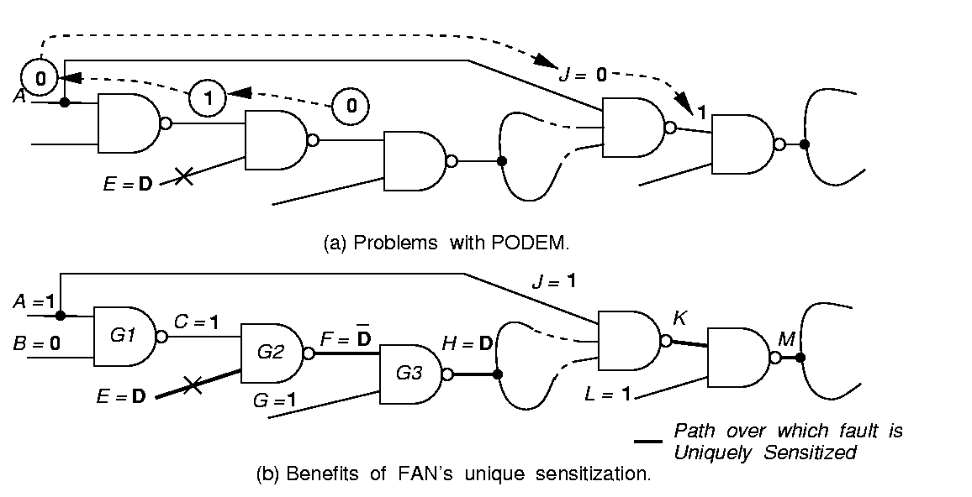
PODEM Makes Unwise Signal Assignments
Blocks fault propagation due to assignment J = 0

Slide 8
Unique Sensitization of FAN with No Search
Path over which fault is uniquely sensitized
FAN immediately sets necessary signals to propagate fault

Slide 9
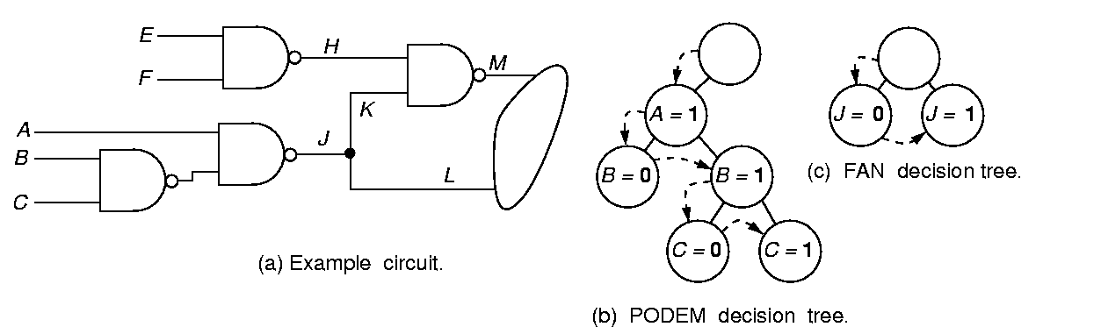
Headlines
Headlines H and J separate circuit into 3 parts, for which test generation can be done independently

Slide 10
Contrasting Decision Trees
FAN decision tree
PODEM decision tree

Slide 11
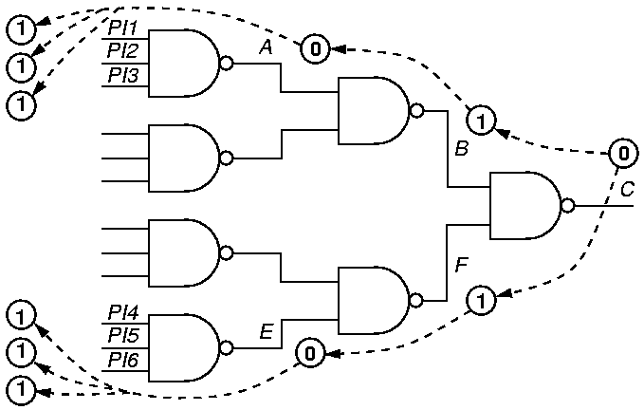
Multiple Backtrace
FAN – breadth-first
passes –
1 time
PODEM –
depth-first
passes – 6 times

Slide 12
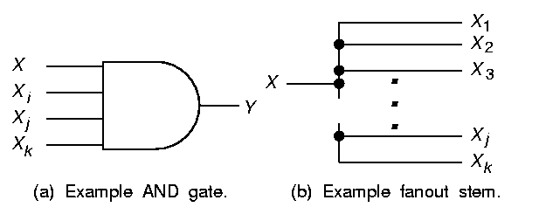
AND Gate Vote Propagation
[5, 3]
[5, 3]
0
0
0
0
0
[0, 3]
[0, 3]
1
1
1
[0, 3]
AND Gate
  Easiest-to-control Input:
    # 0’s = OUTPUT # 0’s
    # 1’s = OUTPUT # 1’s
  All other inputs:
    # 0’s = 0
    # 1’s = OUTPUT # 1’s

Slide 13
Multiple Backtrace Fanout Stem Voting
[5, 1]
[1, 1]
[18, 6]
[3, 2]
[4, 1]
[5, 1]
Fanout Stem --
  # 0’s = Σ Branch # 0’s,
  # 1’s = Σ Branch # 1’s

Slide 14
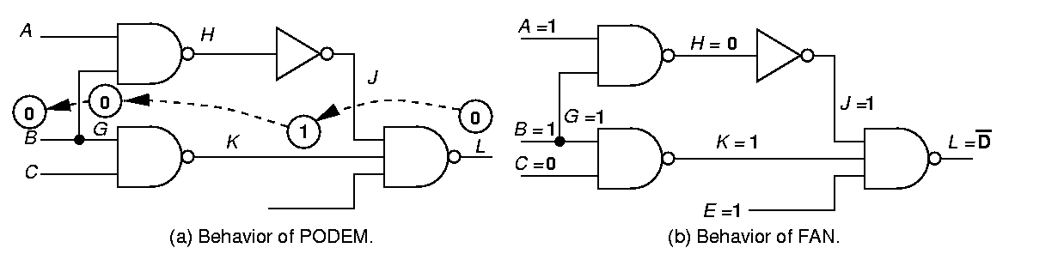
PODEM Fails to Determine Unique Signals
_{sa1}
Backtracing operation fails to set all 3 inputs of gate L to 1
  Causes unnecessary search

Slide 15
FAN -- Early Determination of Unique Signals
_{sa1}
Determine all unique signals implied by current decisions immediately
  Avoids unnecessary search

Slide 16
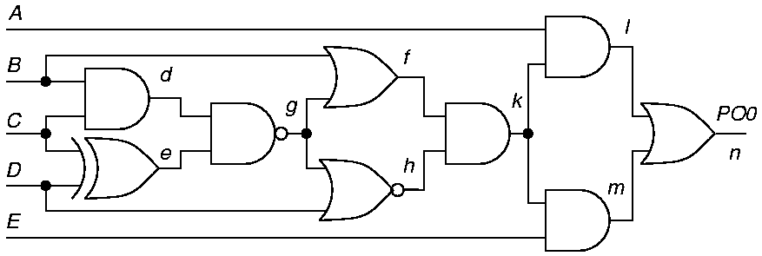
TOPS: Dominators
Kirkland and Mercer (1987)
Dominator of g – all paths from g to PO must pass through the dominator
  Absolute -- k dominates B
  Relative – dominates only paths to a given PO
  If dominator of fault becomes 0 or 1, backtrack

Slide 17
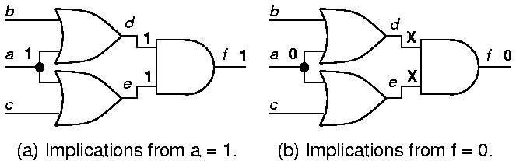
SOCRATES: Learning (1988)
Static and dynamic learning:
a = 1 f = 1 means that we learn f = 0 a = 0
by applying the Boolean contrapositive theorem
  Set each signal first to 0, and then to 1
  Discover implications
  Learning criterion: remember f = v_{f} only if:
    f = v_{f} requires all inputs of f to be non-controlling
    A forward implication contributed to f = v_{f}

Slide 18
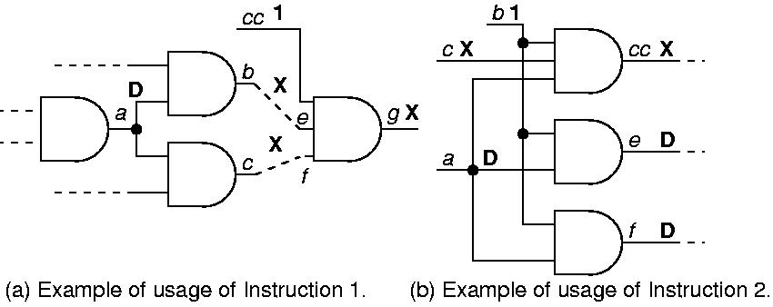
Improved Unique Sensitization Procedure
When a is only D-frontier signal, find dominators of a and set their inputs unreachable from a to 1
Find dominators of single D-frontier signal a and make common input signals non-controlling

Slide 19
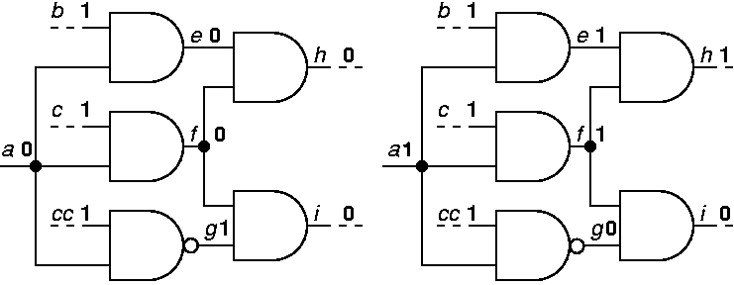
Constructive Dilemma
[(a = 0) (i = 0)] [(a = 1) (i = 0)] (i = 0)
If both assignments 0 and 1 to a make i = 0, then i = 0 is implied independently of a

Slide 20
EST: Search Space Learning (Giraldi and Bushnell)
E-frontier – partial circuit functional decomposition
  Equivalent to a node in a BDD
  Cut-set between circuit part with known labels and part with X signal labels
EST learns E-frontiers during ATPG and stores them in a hash table
  Dynamic programming – when new decomposition generated from implications of a variable assignment, looks it up in the hash table
  Avoids repeating a search already conducted
Terminates search when decomposition matches:
  Earlier one that lead to a test (retrieves stored test)
  Earlier one that lead to a backtrack
Accelerated SOCRATES nearly 5.6 times

Slide 21
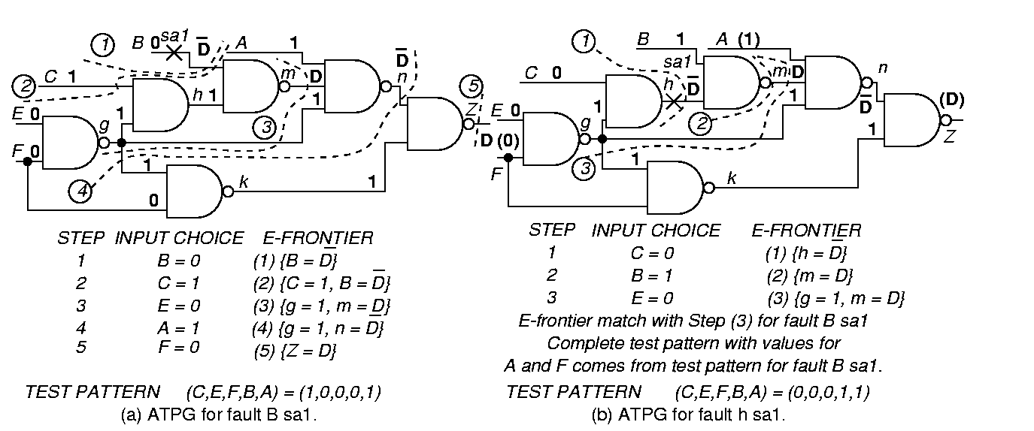
Fault B sa1

Slide 22
Fault h sa1

Slide 23
Summary
Performance improvement through 40 years of research.
Algorithm
D-ALG
PODEM
FAN
TOPS
SOCRATES
Waicukauski et al.
EST
TRAN
Recursive learning
Tafertshofer et al.
Est. speedup over D-ALG
(normalized to D-ALG time)
1
7
23
292
1574 ATPG System
2189 ATPG System
8765 ATPG System
3005 ATPG System
485
25057
Year
1966
1981
1983
1987
1988
1990
1991
1993
1995
1997

